Slide 1
INPUT/OUTPUT
Tanjina Helaly

Slide 2
Input/Output in Java
The java.io package - classes to perform input and output (I/O) in Java.
All these streams represent
an input source and
an output destination.
supports many data such as primitives, Object, localized characters, etc.

Slide 3
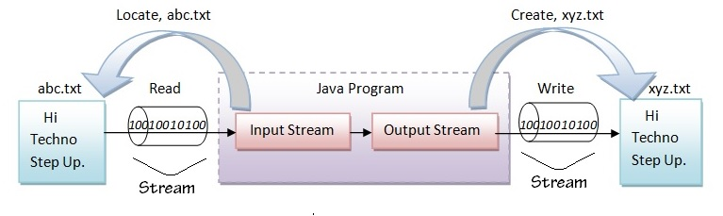
Stream
A stream can be defined as a sequence of data. there are two kinds of Streams
The Input Stream is used to read data from a source.
The Output Stream is used for writing data to a destination.
Always close a stream when it's no longer needed
This practice helps avoid serious resource leaks.

Slide 4
I/O Stream Classifications
Byte Streams handle I/O of raw binary data.
Character Streams handle I/O of character data, automatically handling translation to and from the local character set.
Buffered Streams optimize input and output by reducing the number of calls to the native API.
Scanning and Formatting allows a program to read and write formatted text.
I/O from the Command Line describes the Standard Streams and the Console object.
Data Streams handle binary I/O of primitive data type and String values.
Object Streams handle binary I/O of objects.

Slide 5
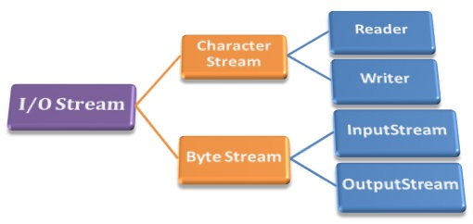
2 main I/O Stream
Among the previously listed categories, two main category of IO classes are,
Character- Oriented Stream: It has two abstract classes Reader and Writer
Byte- Oriented Stream: It has two abstract classes InputStream and OutputStream

Slide 6
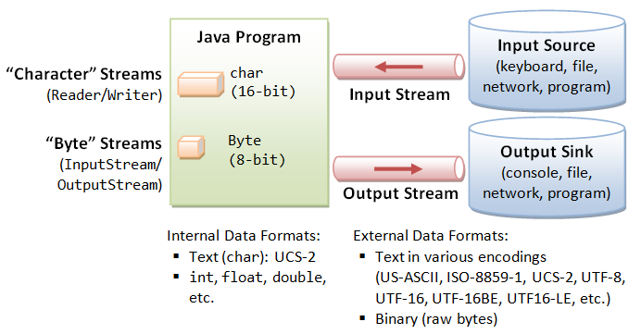
2 main I/O Stream

Slide 7
Byte Format
Programs use byte streams to perform input and output of 8-bit bytes.
Base Class | Console | File | Methods
InputStream | System.in | FileInputStream(String) Or FileInputStream(File) | read() – return int (ASCII value of the character)
OutputStream | System.out(PrintStream) | FileOutputStream(String) Or FileOutputStream(File) | write(int) write(byte[])

Slide 8
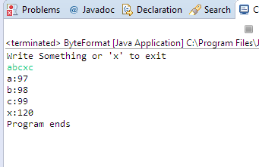
Byte Format – From Standard Input
import java.io.*;
public class ByteFormat {
public static void main(String[] args) {
InputStream is = System.in;
int a=0;
System.out.println("Write Something or 'x' to exit");
while (a != 'x'){
try {
a = is.read();
System.out.println((char)a +":"+a);
} catch (IOException e) {
e.printStackTrace();
}
}
try { is.close();}
catch (IOException e) { e.printStackTrace();}
System.out.println("Program ends");
}
}
Program Output

Slide 9
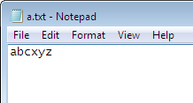
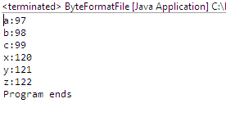
Byte Format – From File
import java.io.*;
public class ByteFormatFile {
public static void main(String[] args) {
int a=0;
FileInputStream fis;
try {
fis = new FileInputStream("C:\\Temp\\a.txt");
while((a = fis.read()) != -1)
System.out.println((char)a +":"+a);
fis.close();
}
catch (FileNotFoundException e1) {
e1.printStackTrace();
} catch (IOException e) {
e.printStackTrace();
}
System.out.println("Program ends");
}
}
File Content
Program Output

Slide 10
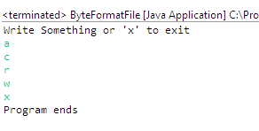
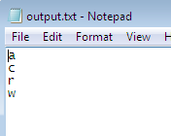
Byte Format – Write to File
import java.io.*;
public class ByteFormatFile {
public static void main(String[] args) {
int a=0;
FileOutputStream fos;
InputStream is = System.in;
try {
fos = new FileOutputStream("C:\\Temp\\output.txt");
System.out.println("Write Something or 'x' to exit");
while ((a=is.read()) != 'x'){
fos.write(a);
}
fos.close();
}
catch (FileNotFoundException e1) {
e1.printStackTrace();
} catch (IOException e) {
e.printStackTrace();
}
System.out.println("Program ends");
}
}
Program Output
File Content

Slide 11
PrintStream
Derived from OutputStream
The PrintStream class provides methods to write data to another stream(OutputStream, BufferedWriter, OutputStreamWriter).
The PrintStream class automatically flushes the data so there is no need to call flush() method.
Moreover, its methods don't throw IOException.

Slide 12
PrintStream
Constructor and Description
PrintStream(File file) Creates a new print stream, without automatic line flushing, with the specified file.
PrintStream(File file, String csn) Creates a new print stream, without automatic line flushing, with the specified file and charset.
PrintStream(OutputStream out) Creates a new print stream.
PrintStream(OutputStream out, boolean autoFlush) Creates a new print stream.
PrintStream(OutputStream out, boolean autoFlush, String encoding) Creates a new print stream.
PrintStream(String fileName) Creates a new print stream, without automatic line flushing, with the specified file name.
PrintStream(String fileName, String csn) Creates a new print stream, without automatic line flushing, with the specified file name and charset.

Slide 13
PrintStream
Modifier and Type | Method and Description
PrintStream | append(char c) Appends the specified character to this output stream.
PrintStream | append(CharSequence csq) Appends the specified character sequence to this output stream.
PrintStream | append(CharSequence csq, int start, int end) Appends a subsequence of the specified character sequence to this output stream.
boolean | checkError() Flushes the stream and checks its error state.
protected void | clearError() Clears the internal error state of this stream.
void | close() Closes the stream.
void | flush() Flushes the stream.
void | print(boolean b) Prints a boolean value.
void | print(Object obj) Prints an object.
void | println(Object x) Prints an Object and then terminate the line.
void | println(String x) Prints a String and then terminate the line.
void | write(byte[] buf, int off, int len) Writes len bytes from the specified byte array starting at offset off to this stream.
void | write(int b) Writes the specified byte to this stream.

Slide 14
PrintStream
Notes
print/println() –
has overloaded method for each primitive data, String and any Reference data.
For reference data print/println prints the output of the toString() method.
If the class doesn’t override the toString() method, it will use the toString method of Object class which return the [classname@hashcode]
write()
works the same way as OutputStream
It takes the int input as the ASCII value and print the corresponding character

Slide 15
Character Format
Handle I/O of character data, automatically handling translation to and from the local character set.
Base Class | Console | File | Method
Reader | InputStreamReader(System.in) | FileReader(String) or FileReader(File) | read() – return int (ASCII character of the character)
Writer | OutputStreamWriter(System.out) | FileWriter(String) Or FileWriter(File) | write(int) write(String) append(char)

Slide 16
Buffered Format
For unbuffered I/O.
each read or write request is handled directly by the underlying OS.
since each such request often triggers
disk access,
network activity, or
some other operation that is relatively expensive.
To reduce this kind of overhead – Buffered Stream
Buffered input streams read data from a memory area known as a buffer;
the native input API is called only when the buffer is empty.
Similarly, buffered output streams write data to a buffer,
the native output API is called only when the buffer is full.

Slide 17
Buffered Format
There are four buffered stream classes used to wrap unbuffered streams:
BufferedInputStream and BufferedOutputStream create buffered byte streams,
BufferedReader and BufferedWriter create buffered character streams.
Flushing Buffered Streams
Sometime we need to write out a buffer at critical points, without waiting for it to fill.

Slide 18
Buffered Byte Format
Handle I/O of character data, automatically handling translation to and from the local character set.
Base Class | Console | File | Method
BufferedInputStream(InputStream) | BufferedInputStream (System.in) | BufferedInputStream (FileInputStream(String or File)) | read() – return int (ASCII character of the character)
BufferedOutputStream(OutputStream) | BufferedOutputStream(System.out) | BufferedOutputStream (FileOutputStream(String or File) | write(int) write(byte[])

Slide 19
Buffered Character Format
Handle I/O of character data, automatically handling translation to and from the local character set.
Base Class | Console | File | Method
BufferedReader(Reader) | BufferedReader(InputStreamReader(System.in) | BufferedReader(FileReader(String or File)) | read() – return int readLine()
BufferedWriter(Writer) | BufferedWriter(OutputStreamWriter(System.out)) | BufferedWriter(FilerWriter(String or File)) | write(String) newLine() flush()

Slide 20
Data Stream Format
Data streams support binary I/O of primitive data type values (boolean, char, byte, short, int, long, float, and double) as well as String values.
Base Class | Console | File | Method
DataInput(interface) InputStream | DataInputStream (System.in) or DataInputStream (BufferedInputStream(System.in)) | DataInputStream (FileInputStream) or DataInputStream (BufferedInputStream(FileInputStream)) | int i = dis.read(); boolean b = dis.readBoolean(); String s1 = dis.readLine(); String s2 = dis.readUTF();
DataOutput(Interface) OutputStream | DataOutputStream(System.out) or DataOutputStream(BufferedOutputStream(System.out)) | DataOutputStream (FileOutputStream) or DataOutputStream (BufferedOutputStream(FileOutputStream)) | writeInt(int); writeUTF(String); writeByte(int); writeBoolean(boolean); write(int);

Slide 21
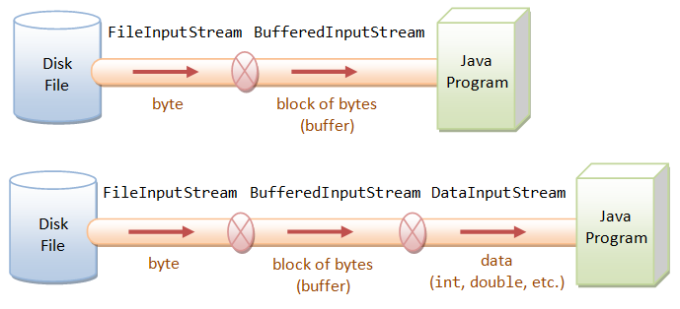
Pictorial representation of different format.

Slide 22
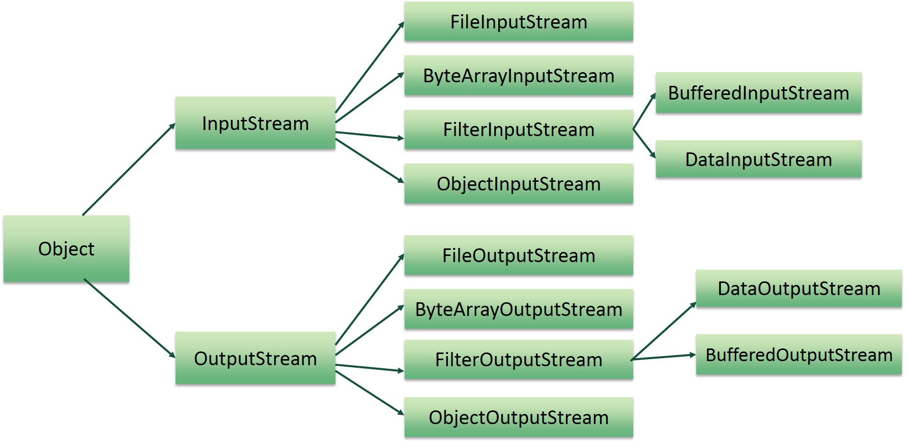
Stream Hierarchy

Slide 23
PrintWriter
Is one of the character-based classes.
Using a character-based class for console output makes internationalizing your program easier.
PrintWriter contains higher level output methods to write data.
Print() and println() prints any kind of data,
If an argument of print/println is not primitive type, the PrintWriter methods call the object’s toString( ) method and then display the result.
Like PrintStream, PrintWriter’s methods don't throw IOException.

Slide 24
PrintWriter
Constructors:
PrintWriter(File file)
This creates a new PrintWriter, without automatic line flushing, with the specified file.
PrintWriter(OutputStream out)
This creates a new PrintWriter, without automatic line flushing, from an existing OutputStream.
PrintWriter(OutputStream out, boolean autoFlush) – most commonly used
This creates a new PrintWriter from an existing OutputStream
PrintWriter(String fileName)
This creates a new PrintWriter, without automatic line flushing, with the specified file name.
PrintWriter(Writer out)
This creates a new PrintWriter, without automatic line flushing.
PrintWriter(Writer out, boolean autoFlush)
This creates a new PrintWriter.

Slide 25
PrintWriter - methods
Modifier and Type | Method and Description
PrintWriter | append(char c)Appends the specified character to this writer.
void | close()Closes the stream and releases any system resources associated with it.
void | flush()Flushes the stream.
void | print(boolean b)Prints a boolean value.
void | print(char c)Prints a character.
void | print(char[] s)Prints an array of characters.
void | print(double d)Prints a double-precision floating-point number.
void | print(float f)Prints a floating-point number.
void | print(int i)Prints an integer.
void | print(long l)Prints a long integer.
void | print(Object obj)Prints an object.
void | print(String s)Prints a string.
PrintWriter | printf(String format, Object... args)A convenience method to write a formatted string to this writer using the specified format string and arguments.
void | println()Terminates the current line by writing the line separator string.
void | println(boolean x)Prints a boolean value and then terminates the line.
void | println(char x)Prints a character and then terminates the line.
void | println(char[] x)Prints an array of characters and then terminates the line.

Slide 26
PrintWriter - methods
Modifier and Type | Method and Description
void | println(double x)Prints a double-precision floating-point number and then terminates the line.
void | println(float x)Prints a floating-point number and then terminates the line.
void | println(int x)Prints an integer and then terminates the line.
void | println(long x)Prints a long integer and then terminates the line.
void | println(Object x)Prints an Object and then terminates the line.
void | println(String x)Prints a String and then terminates the line.
protected void | setError()Indicates that an error has occurred.
void | write(char[] buf)Writes an array of characters.
void | write(char[] buf, int off, int len)Writes A Portion of an array of characters.
void | write(int c)Writes a single character.
void | write(String s)Writes a string.
void | write(String s, int off, int len)Writes a portion of a string.

Slide 27
Example - Copy from a file
import java.io.*;
public class CopyFIle {
public static void main(String[] args) {
File inFile = new File("input.txt");
PrintWriter pw = null;
BufferedReader br = null;
try {
br = new BufferedReader(new FileReader(inFile));
pw = new PrintWriter("output.txt");
String data = br.readLine();
while(data != null){
pw.println(data);
data = br.readLine();
}
} catch (IOException e1) {
e1.printStackTrace();
}finally{
try {
br.close();
} catch (IOException e) {
e.printStackTrace();
}
pw.close();
}
}
}

Slide 28
Resource Management-autoclosing
JDK 7 added a new feature to manage resources, such as file streams, by automating the closing process.
This feature is known as automatic resource management, or ARM for short, is based on an expanded version of the try statement.
The principal advantage of automatic resource management is that
it prevents situations in which a file (or other resource) is inadvertently not released after it is no longer needed.
Forgetting to close a file can result in memory leaks, and could lead to other problems.

Slide 29
Resource Management-autoclosing
General Form
try (resource-specification) {
// use the resource
}
The try-with-resources statement can be used only with those resources that implements
Either the AutoCloseable interface defined in java.lang
Or Closeable(subclass of AutoClosable) interface in java.io.
Both interfaces are implemented by the stream classes.
Thus, try-with-resources can be used when working any stream.

Slide 30
Example – Copy file(autoclosing)
import java.io.*;
public class CopyFile1 {
public static void main(String[] args) {
File inFile = new File("input.txt");
File outFile = new File("output.txt");
// br and pw wil be automatically closed after try block exits
try (BufferedReader br = new BufferedReader(new FileReader(inFile));
PrintWriter pw = new PrintWriter(outFile)){
String data = br.readLine();
while(data != null){
pw.println(data);
data = br.readLine();
}
} catch (IOException e1) {
e1.printStackTrace();
}
}
}

Slide 31
File Class – in java.io package
Java File class represents the files and directory pathnames in an abstract manner.
This class is used for creation of files and directories, file searching, file deletion, etc.
But not for reading/writing to file.
Constructor and Description
File(File parent, String child)Creates a new File instance from a parent abstract pathname and a child pathname string.
File(String pathname)Creates a new File instance by converting the given pathname string into an abstract pathname.
File(String parent, String child)Creates a new File instance from a parent pathname string and a child pathname string.
File(URI uri)Creates a new File instance by converting the given file: URI into an abstract pathname.

Slide 32
File Class – in java.io package
Modifier and Type | Method and Description
boolean | createNewFile()Atomically creates a new, empty file named by this abstract pathname if and only if a file with this name does not yet exist.
boolean | delete()Deletes the file or directory denoted by this abstract pathname.
boolean | exists()Tests whether the file or directory denoted by this abstract pathname exists.
String | getAbsolutePath()Returns the absolute pathname string of this abstract pathname.
String | getName()Returns the name of the file or directory denoted by this abstract pathname.
String | getParent()Returns the pathname string of this abstract pathname's parent, or null if this pathname does not name a parent directory.
File | getParentFile()Returns the abstract pathname of this abstract pathname's parent, or null if this pathname does not name a parent directory.
String | getPath()Converts this abstract pathname into a pathname string.

Slide 33
File Class – in java.io package
Modifier and Type | Method and Description
boolean | isDirectory()Tests whether the file denoted by this abstract pathname is a directory.
boolean | isFile()Tests whether the file denoted by this abstract pathname is a normal file.
String[] | list()Returns an array of strings naming the files and directories in the directory denoted by this abstract pathname.
File[] | listFiles()Returns an array of abstract pathnames denoting the files in the directory denoted by this abstract pathname.
boolean | mkdir()Creates the directory named by this abstract pathname.
boolean | mkdirs() Creates the directory named by this abstract pathname, including any necessary but nonexistent parent directories.
boolean | renameTo(File dest)Renames the file denoted by this abstract pathname.
Path | toPath()Returns a java.nio.file.Path object constructed from the this abstract path.
String | toString()Returns the pathname string of this abstract pathname.

Slide 34
File I/O (Featuring NIO.2)
The java.nio.file package
provide comprehensive support for file I/O and for accessing the default file system.
Checking a File or Directory

Slide 35
Files Class -in java.nio.file package
Modifier and Type | Method and Description
static long | copy(InputStream in, Path target, CopyOption... options)Copies all bytes from an input stream to a file.
static long | copy(Path source, OutputStream out)Copies all bytes from a file to an output stream.
static Path | copy(Path source, Path target, CopyOption... options)Copy a file to a target file.
static Path | createDirectories(Path dir, FileAttribute<?>... attrs)Creates a directory by creating all nonexistent parent directories first.
static Path | createDirectory(Path dir, FileAttribute<?>... attrs)Creates a new directory.
static Path | createFile(Path path, FileAttribute<?>... attrs)Creates a new and empty file, failing if the file already exists.
static void | delete(Path path)Deletes a file.
static boolean | deleteIfExists(Path path)Deletes a file if it exists.
static boolean | exists(Path path, LinkOption... options)Tests whether a file exists.
static Object | getAttribute(Path path, String attribute, LinkOption... options)Reads the value of a file attribute.
static <V extends FileAttributeView> V | getFileAttributeView(Path path, Class<V> type, LinkOption... options)Returns a file attribute view of a given type.

Slide 36
Files Class -in java.nio.file package
Modifier and Type | Method and Description
static boolean | isDirectory(Path path, LinkOption... options)Tests whether a file is a directory.
static boolean | isSameFile(Path path, Path path2)Tests if two paths locate the same file.
static Path | move(Path source, Path target, CopyOption... options)Move or rename a file to a target file.
static BufferedReader | newBufferedReader(Path path, Charset cs)Opens a file for reading, returning a BufferedReader that may be used to read text from the file in an efficient manner.
static BufferedWriter | newBufferedWriter(Path path, Charset cs, OpenOption... options)Opens or creates a file for writing, returning a BufferedWriter that may be used to write text to the file in an efficient manner.
static InputStream | newInputStream(Path path, OpenOption... options)Opens a file, returning an input stream to read from the file.
static OutputStream | newOutputStream(Path path, OpenOption... options)Opens or creates a file, returning an output stream that may be used to write bytes to the file.
static boolean | notExists(Path path, LinkOption... options)Tests whether the file located by this path does not exist.
static byte[] | readAllBytes(Path path)Reads all the bytes from a file.
static List<String> | readAllLines(Path path, Charset cs)Read all lines from a file.

Slide 37
Reference
Java: Complete Reference - Chapter 13, 20, 21

